Slide 1

Strategic Growth Insights from Customer Pain Points
Ubong Udoekwere
Julio Ramirez Bernal
Marc Kiobola
Notes:
Opening Hook (15s): Good day XXXX. Today I'm going to present a data-driven growth strategy for Wealthsimple that leverages competitor weaknesses to drive customer acquisition and support Wealthsimple's continued growth.
The strategic insights proposed are built on real world data of over 140k customer complaints filed against digital finance platforms in the last 5 years. These complaints represent competitor failures and potential customer churn that WS can leverage
Transition (5 seconds): I am going to start by framing the business context and problem we're solving
These competitor failures could translate in a $2.8B growth opportunity hiding in plain sight—competitor failures we can exploit immediately
$2.8B growth opportunity Assumption: The average retail investor portfolio size with a fintech platform like RobinHood in the US in 2023 was ~$20,000 (https://brokerchooser.com/education/news/data-dashboard/brokerage-account-sizes)

Slide 2
Introduction
WS Strength & Enablers:
Tech-first agility
Regulatory agility
Risk appetite
User experience and accessibility
Margin/options is growth driver → $100B AUM Milestone
Opportunity:
Leverage core strengths to solve customer pain points that competitors struggle to address
Sustain continued growth as digital finance market matures
Business Context:
WS has grown rapidly in recent years
Reached $100B AUM in Oct 2025 (93% YoY growth)
Risk of growth saturation as digital finance market matures
Problem Statement
How can Wealthsimple differentiate itself from traditional financial institutions by addressing common customer complaints?
Notes:
Business Context (30 seconds): "First, what is the current state of affairs for WS. Wealthsimple has grown rapidly, but faces potential growth risk as the digital finance market matures
Problem Statement (20 seconds):
Why This Matters (20 seconds): WS has been growing rapidly over the last 10 years, but sustaining this growth requires capturing market share from struggling competitors. In the last 5 years, we have also seen rapid growth in customer complaints against digital finance platforms, particularly with WS competitors like Block, Chime, Robinhood, and Paypal. These are dissatisfied customers actively looking for alternatives, and WS could position itself as that alternative, leveraging its core strengths and competencies to address the growing unmet need in the digital finance market
Total: ~1 minute 40 seconds

Slide 3

Wealthsimple's Strategic Advantage
Tech-First DNA
No legacy systems—rapid product deployment vs traditional banks
Regulatory Agility
Less hurdles than traditional banks
Faster innovation approval
Risk Appetite
Equity access/High credit default risk
WS Introduced Margin trading service in 2025: High financial and operational risks
Margin Trading as Growth Driver
Margin trading is likely a major contributor to AUM growth in 2025
Strong demand and promotional campaigns
Attracts broader client base

Slide 4
Our Approach
Data Source
Consumer Complaint Data sourced from CFPB
Assumptions
CFPB US data can be generalized to Canadian Market
Questions
Common customer complaints
Products impacted by these complaints
Competitors impacted
Opportunity
Customer pain points presents acquisition opportunities
How can WS address customer pain points?
Notes:
The analytical approach we took to tackling this problem involved followed
Data Source (20 seconds):
"Our data science team analyzed over 140k US based complaints against digital finance platforms from the CFPB, and we identified complaint trends and themes associated with digital finance products and services
Clarifying our assumptions (25 seconds):
"Phase two: We made some Key assumptions to ground our analysis.
CPFB US complaints are also representative of Canadian market
Complaint patterns reflect systemic product failures, and are not one-off issues.
Complaints are a lagging indicator of broader customer dissatisfaction and silent churns
Finally, we settled on 3 Analytical questions to drive our analysis and insights. 1) What are the Xxx 2) What xx 3) What
Opportunity (20 seconds):
We believed that answering these questions will allow us to identify customer pain points that competitor and competitor products fail to address……Which presents a growth opportunity for WS.
Transition (10 seconds):
Total: ~1 minute 55 seconds
as a result we did not prioritize complaints resolution time in our analysis matters…. (but acknowledge it could be representative of operational competence or dysfunction)

Slide 5
Key Insights and Trends
Top complaints over time
Top products impacted by complaints
Top companies impacted by complaints

Slide 6
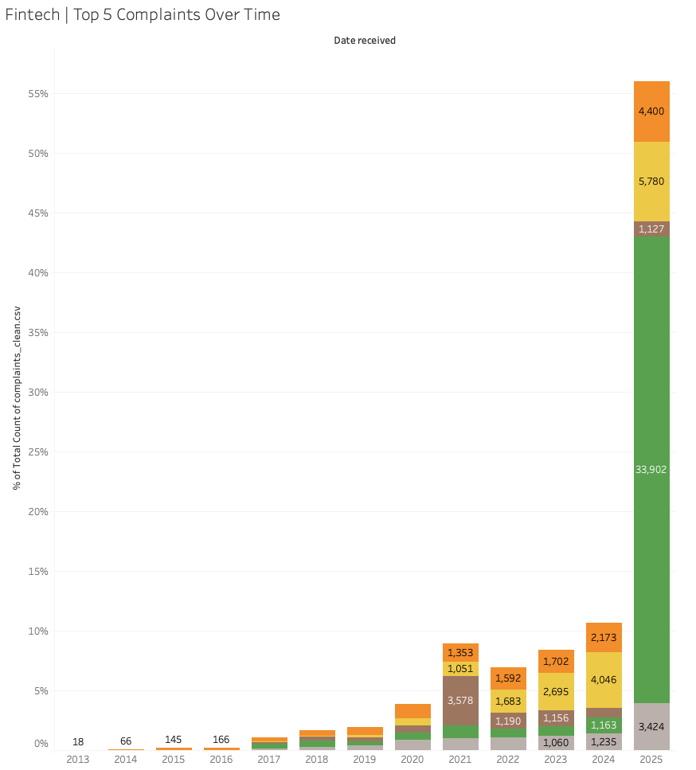
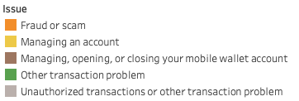
Top Complaints
Over Time
Transaction failures dominate Fintech complaints
Fraud, identity, and credit-data issues
Account-access friction “Managing an account”
Notes:
*“‘Other transaction problem’ is a CFPB-defined catch-all category used when a consumer reports a transaction-related failure that does not match any existing sub-issue. Regulatory guidance shows that this typically includes settlement delays, reconciliation errors, unavailable funds, duplicate or missing transactions, unclear fraud holds, and insufficient status visibility.”
(Sources: CFPB Taxonomy Guide; CFPB Supervisory Highlights 2022–24; OCC Payment Systems Risk Reports; FDIC Complaint Methodology; Payments Canada/FINTRAC Payment Operations Guidance.)
Represents 64.9% of top-five product complaints, making operational reliability the primary dissatisfaction driver.
Account for 20.2% of complaints, often tied to delayed availability, balance mismatches, or routing failures.
Represent 12.7% of complaints, reflecting persistent data-refresh delays across Fintechs.

Slide 7
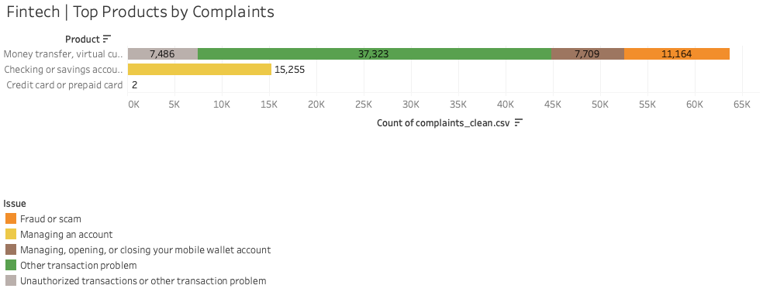
Top Products
Impacted by Complaints
“Money transfer, virtual currency, or money service”
Checking and savings behaviors
Notes:
Represents 64.9% of top-five product complaints, making operational reliability the primary dissatisfaction driver.
Account for 20.2% of complaints, often tied to delayed availability, balance mismatches, or routing failures.

Slide 8
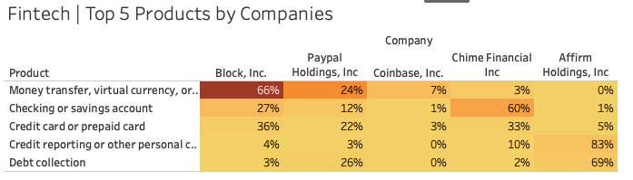
Top Companies Impacted by Complaints
Fintech Complaints Are Dominated by 3 Players;
- Money Movement (Fintech)
Block (Cash App) → 66%
PayPal → 24%
- Checking (Fintech)
Chime → 60%
Block → 27%
Notes:
Two distinct products, Money Movement where Block and Paypal make up 90% of complaints and then Checking where Chime and also Block makes up 87% of top complaints.

Slide 9
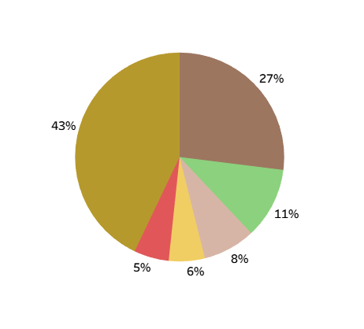
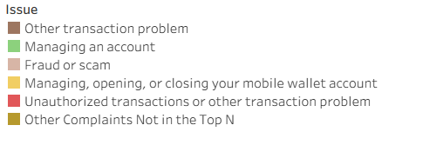
Competitor Struggles: Two Critical Failure Trends
40% — Transaction and Security Issues
Other transaction problem
Fraud/scam
unauthorized transactions
17% — Account Management and Access
Managing an account
Managing, opening, or closing your mobile wallet account

Slide 10
How Wealthsimple Can Differentiate
Action 1: AI-Powered Proactive Support
Gap: 40% of complaints = Transaction and Security Issues
Solution: Fee Transparency + Predictive fraud detection + proactive alerts
All Fees Upfront" guarantee: Zero hidden charges policy
Interactive fee calculator before every transaction
ML detects anomalies 48hrs early + automatic transaction holds + human verification
Action 2: "Guaranteed Access" Promise
Gap: 17% of complaints = Account Management & Access
Solution: Guaranteed liquidity to build trust through reliability
24-hr withdrawal guarantee + Emergency liquidity via margin infrastructure (line of credit or overdraft)
Account status tracker showing why account locked, when it will be reviewed and what is needed to unlock it.
Notes:
Promised to be able to withdraw your funds (up to a specified limit) within 24 hours of requesting a payout—so you don't have to wait longer to access your money in most cases, as some platforms/processors can take several days.​
The emergency liquidity part suggests that you are allowed to instantly access up to to a certain $ amount, even in emergency situations, using margin (which is typically a credit facility or overdraft from the provider)---
-In margin trading, such emergency liquidity is especially important since traders may need to rapidly access cash to meet margin calls, cover losses, or avoid liquidation of positions during market stress. Platforms and institutions manage liquidity risk by having these emergency funds available, either for traders directly or as part of their operational strategy to preserve stability and meet obligations quickly

Slide 11
Key Takeaways & Next Steps
Core Finding: Competitors fail on access and trust —WS can leverage both as a competitive differentiator.
Strategic Fit: Margin revenue + tech agility + risk appetite enable WS to act on these gaps
Recommendation: Deliver AI-powered proactive support and a “Guaranteed Access” promise to prevent transaction issues and eliminate account-access uncertainty.
Notes:
Overall, our findings show that the biggest opportunities for Wealthsimple are not just in fixing problems but they are also in removing uncertainty. Whether it’s access to funds, understanding fees, or knowing what’s happening behind the scenes, customers reward clarity.
These recommendations directly target those gaps and put Wealthsimple in a good position.

Slide 12
Questions?

Slide 13
Appendix: Additional Analysis to Consider
Traditional bank Complaints
Competitor benchmarking (Fintech vs Traditional banks)
Geographic hotspot analysis (where WS could expand)
ID high-risk customer segments most likely to switch

